Slide 1
Multivariate AQ estimation
Employed meteorological data, ground feature data from OSM dataset, etc to estimate PM2.5 and PM10 values.
Totally explain 70% variances (EV), 20% from the ground feature and satellite images, 50% from meteorological effect.
There are city-level fixed effect that cannot be explained by land-use and meteorological data.
Estimated seasonal stationary data as the target variable.
Feature selection, back-propagation, ensembling, etc.
Deploy to aws metaflow with data in s3 bucket.

Slide 2
Image feature semi-supervised learning
From computer vision methodologies, weakly label several images with pores. (recall:, precision:)
Train yolov8 on it and deal with noises. Correct labels.
Continue this process and train a yolo finally on all the data.
Achieved an MAP of …, more robust than professional software, which is based on 2 sets of test data.

Slide 3
Auto-label correction
From the yolov8 works well on small set of data, although with noises. Just better performance than DETR.

Slide 4
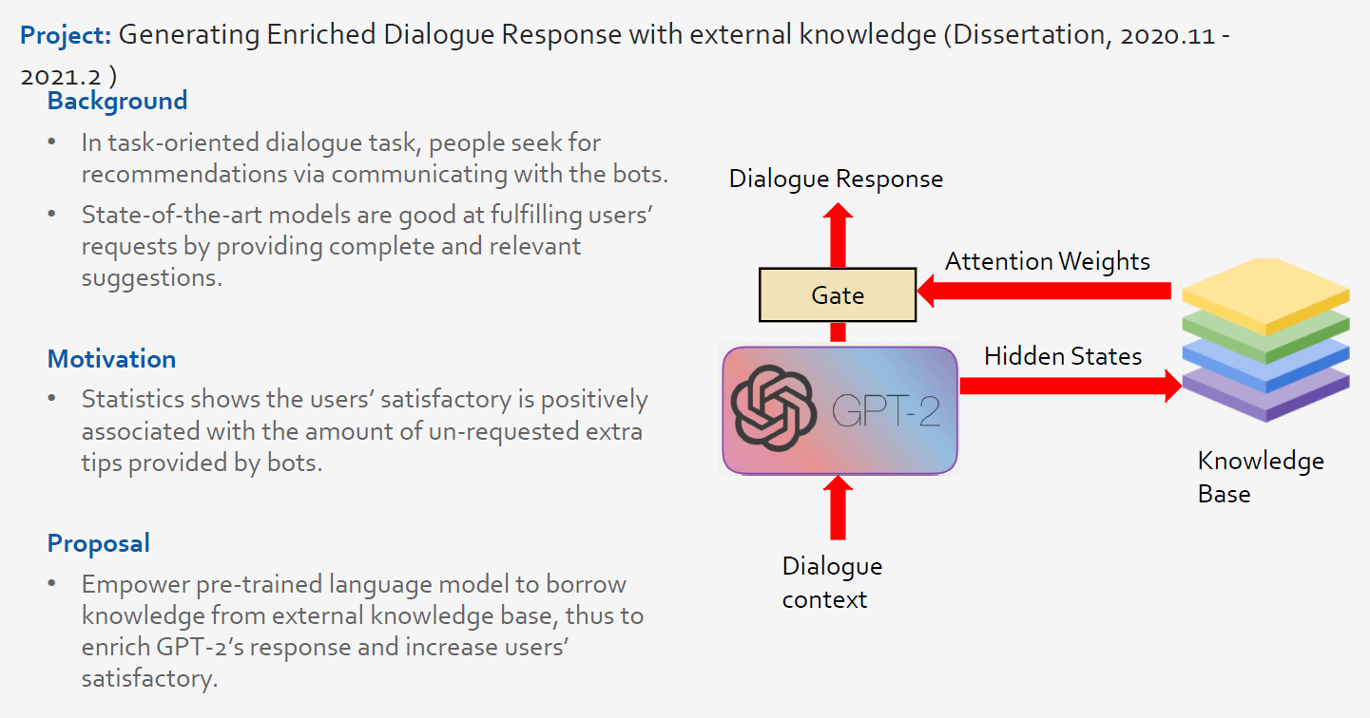

Slide 5
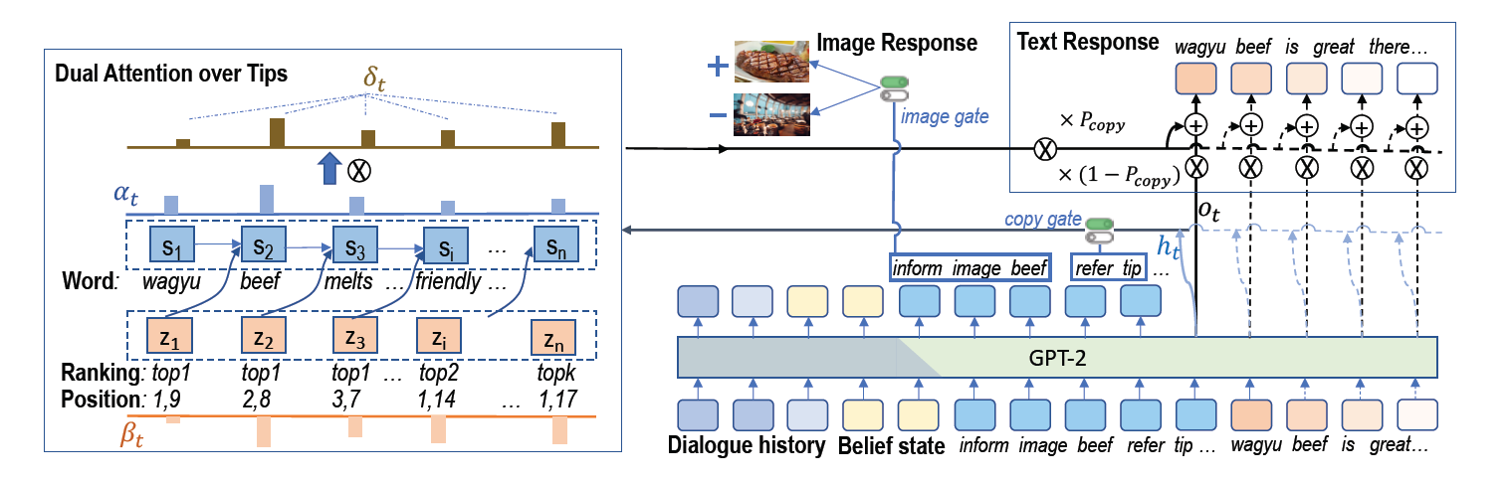
1 GPU V100, GPT-2 117M 10k+ entries of training data. 3 hours

Slide 6
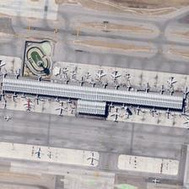
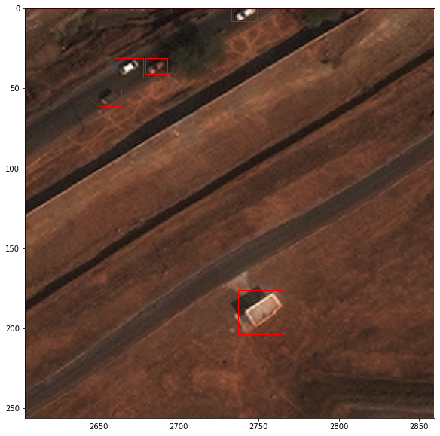
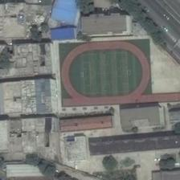
Image Captioning Dataset
Evaluation: RSICD image captioning dataset
ChatGPT verification: manual labelled 100+ images
"Many aircraft are parked next to a long building in an airport."
Three small cars are clustered together in the top left corner of an aerial image.
A building stands alone in the center bottom of an aerial image
“a playground surrounded by many buildings is near to a road”

Slide 7
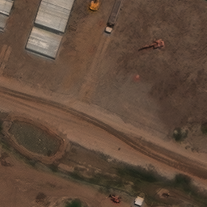
building
truck
building
truck
building
truck
building
excavator
building
excavator
building
excavator
building
building
building
(1)
(2)
(3)

Slide 8
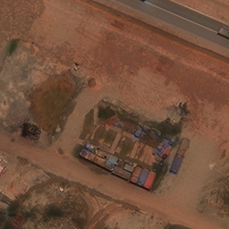
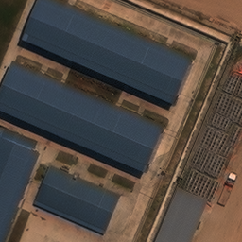
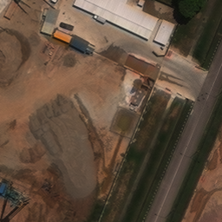
group 0
group 1
group 0
group 1
group 0
group 1
group 2
group 3
Objects/object groups information:
group 0: a line of 5 shipping container
group 1: 2 shipping container
Significant geographical relations:
group 0 is close to group 1
Captions created:
Several shipping containers are arranged in a row in the image.
Two separate containers are located close to a line of shipping containers.
Objects/object groups information:
group 0: 4 building
group 1: 1 truck with flatbed
Significant geographical relations:
group 1 is close to group 0
Captions created:
There are four buildings and a flatbed truck in the image.
The flatbed truck is located near the buildings.
Objects/object groups information:
group 0: 1 mobile crane
group 1: 1 small car
group 2: 1 truck with flatbed
group 3: 5 building
Significant geographical relations:
group 0 is far from other objects
group 1 is surrounded by group 3
group 2 is close to group 3
Captions created:
The image contains a mobile crane, a small car, a flatbed truck, and several buildings.
A mobile crane stands alone far from other objects.
A small car is surrounded by several buildings.
A flatbed truck is located near buildings.
Notes:
Objects/object groups information:
group 0: 1 mobile crane
group 1: 1 small car
group 2: 1 truck with flatbed
group 3: 5 building
Significant geographical relations:
group 1 is surrounded by group 3
group 1 is far from other objects
group 2 is far from other objects

Slide 9
System message:
Today is 13-09-2023, you are a helpful assistant who is proficient at reading satellite images.
Instruction:
You will be provided with description of a satellite image. Please provide several captions as strings in a python list. The image has multiple objects, which have been clustered into groups based on their types and locations. Here are some examples: # example image description 1: ## objects/object groups information group 0: 1 damaged building group 1: a line of 5 building group 2: a line of 3 building ## significant geographical relations group 2 is next to group 0 ## captions ["There are two lines of buildings in the image.", "A damaged building is next to a line of buildings in the image"]
# real image description:
## objects/object groups information
group 0: 1 truck
group 1: a line of 4 building
## significant geographical relations
group 1 is far from other objects
## captions
Response:
["There is a truck and a line of four buildings in the image.",
"The line of buildings is quite far from the truck and other objects."]
Notes:
You will be provided with description of a satellite image. Please provide several captions as strings in a python list. The image has multiple objects, which have been clustered into groups based on their types and locations. Here are some examples: # example image description 1: ## objects/object groups information group 0: 1 damaged building group 1: a line of 5 building group 2: a line of 3 building ## significant geographical relations group 2 is next to group 0 ## captions ["There are two lines of buildings in the image.", "A damaged building is next to a line of buildings in the image"] # example image description 2: ## objects/object groups information group 0: 1 building group 1: 1 building group 2: 1 truck group 3: 2 building, including 1 building, 1 shed group 4: 2 building, including 1 building, 1 damaged building ## significant geographical relations group 3 is next to group 1 ## captions ["There are several buildings and one truck in the image.", "A building and one shed sit side by side", "There is a building and a damaged building standing together.", "Some buildings are very close to each other while some others are not"] # example image description 3: ## objects/object groups information group 0: 1 building group 1: a line of 3 building ## significant geographical relations None ## captions ["There is a solitary building in the image.", "There is a line of three buildings in the image."] # real image description: ## objects/object groups information {objects_information} ## significant geographical relations {objects_relations} ## captions

Slide 10
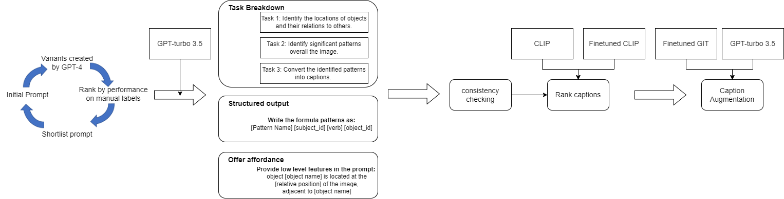
Data Collection Process
Prompt selection
Prompting
Verification
Augmentation
Similarity between GPT captions and manual labels (CIDEr)
63.67
90.09

Slide 11
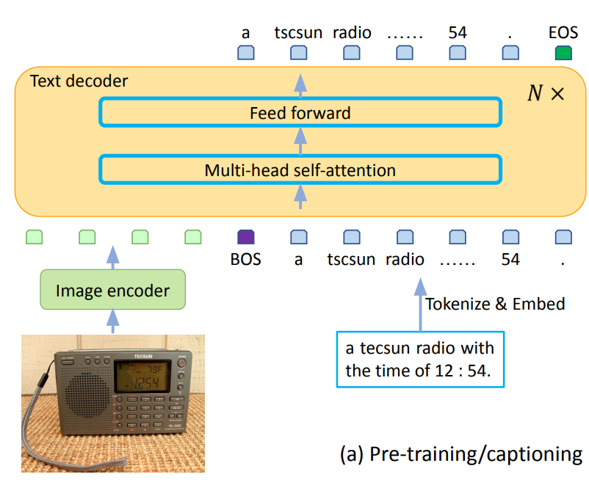
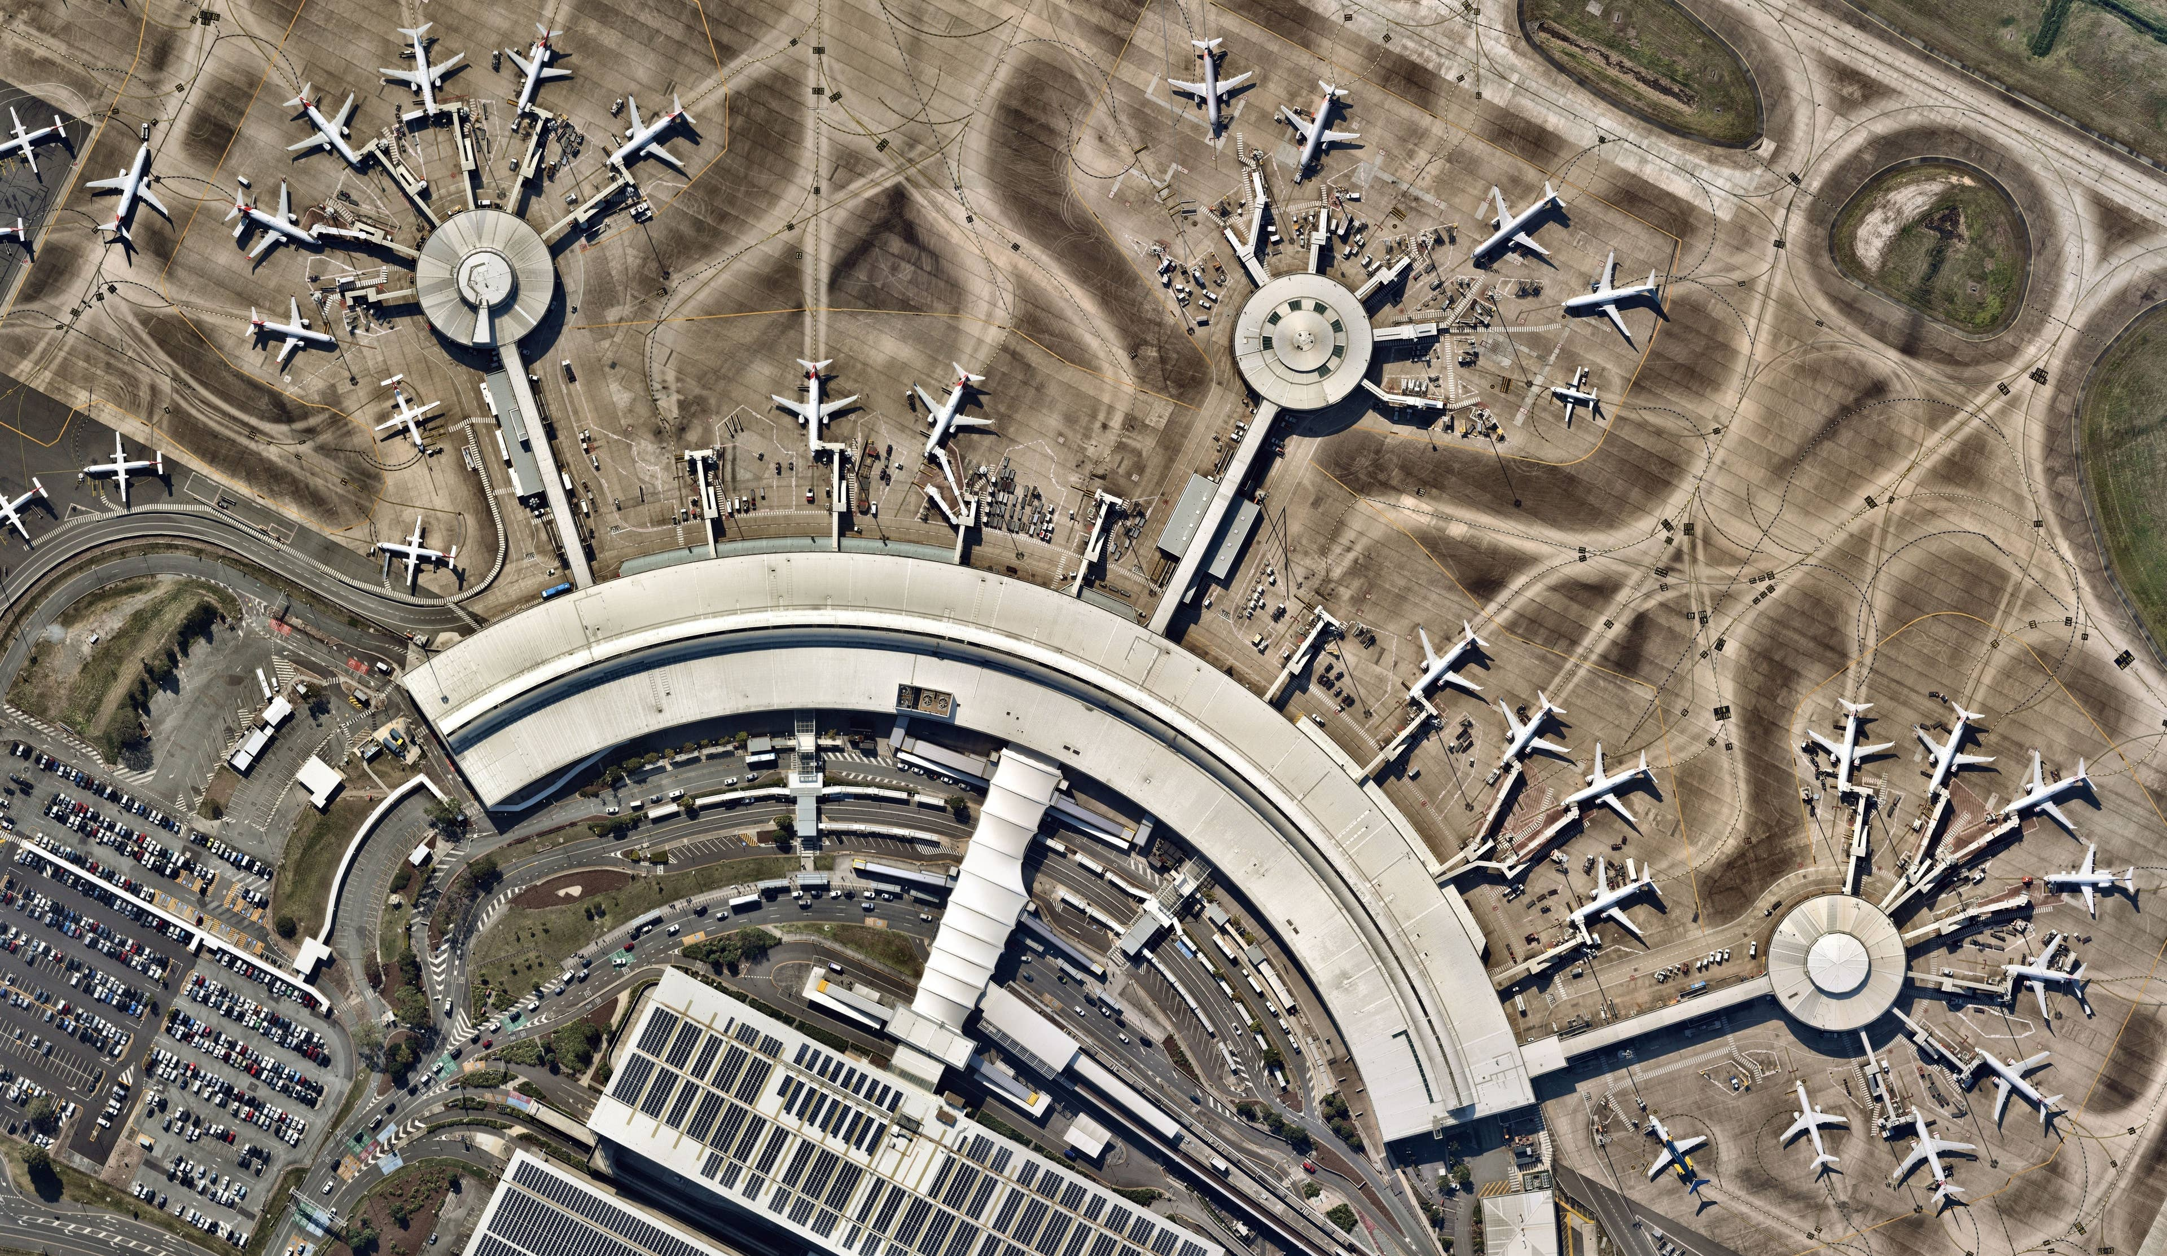
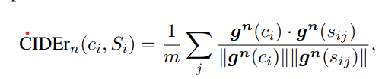

8k entries of data generated. 20 times per image. 1k tokens per query.
Finetune GIT model: 129M parameters, 1 A100 GPU, 1 hour
CIDEr: 85.91
many aircraft are parked near a large building in an airport.
N = 4

Slide 12
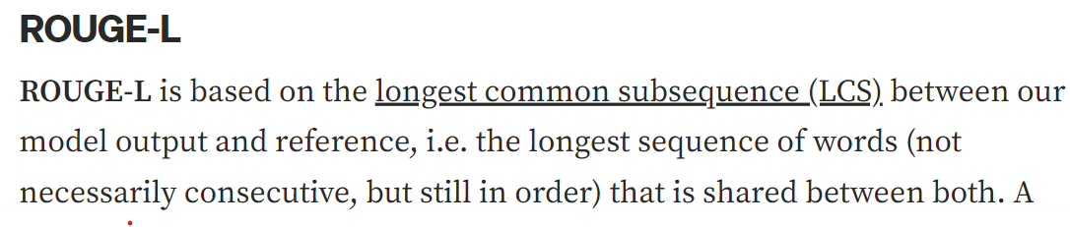
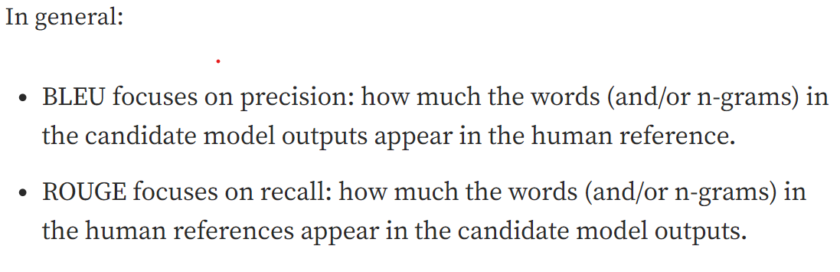
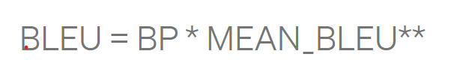
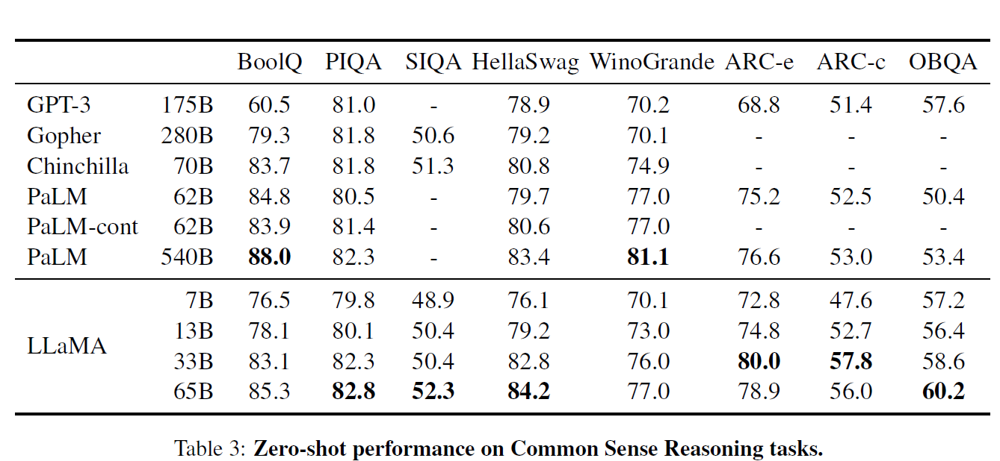
Evaluation metrics: why use CIDER, what is BLEU, Rouge, WER, etc. only for less open ended questions.

Slide 13
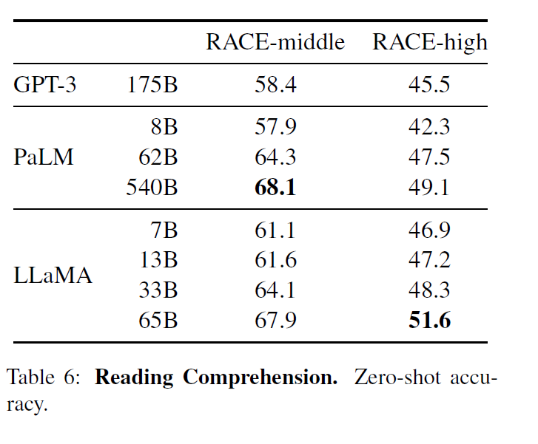
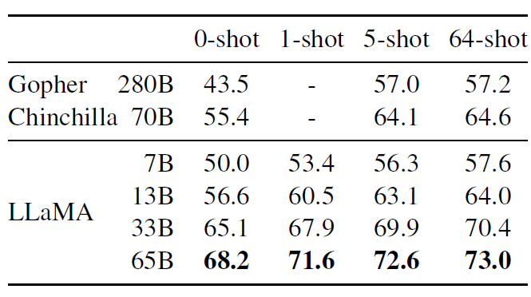
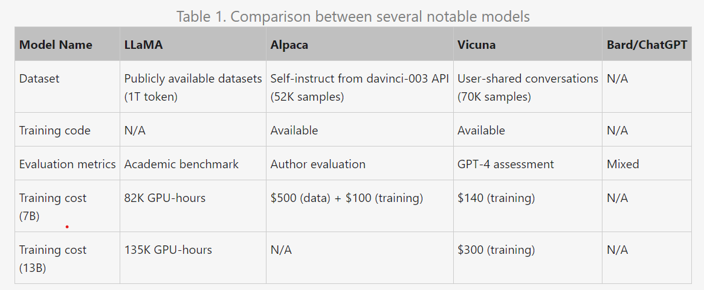
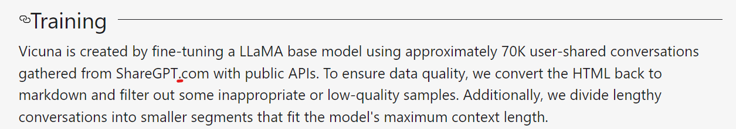
3hrs with batch size=32

Slide 14
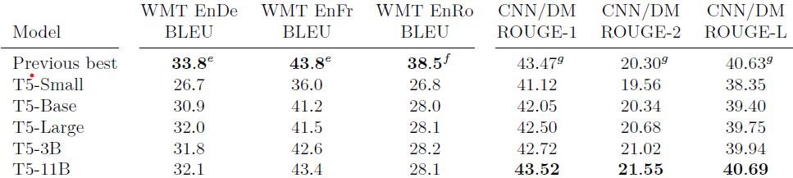
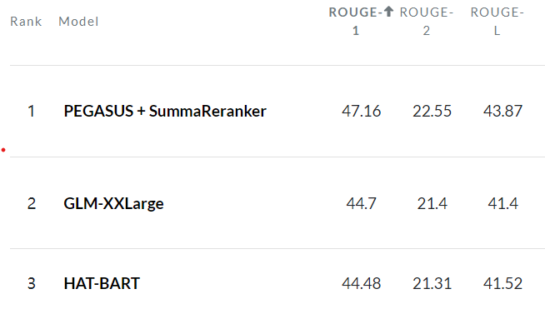
60M
220M
770M

Slide 15
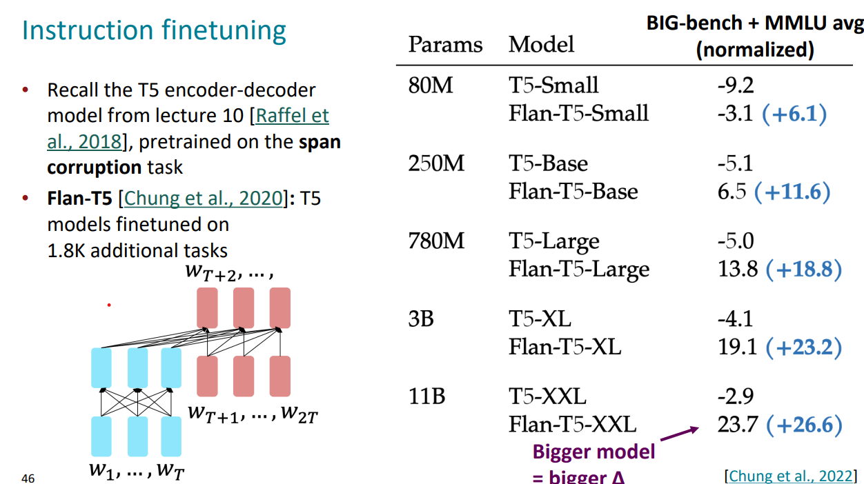

Slide 16
